Slide 1


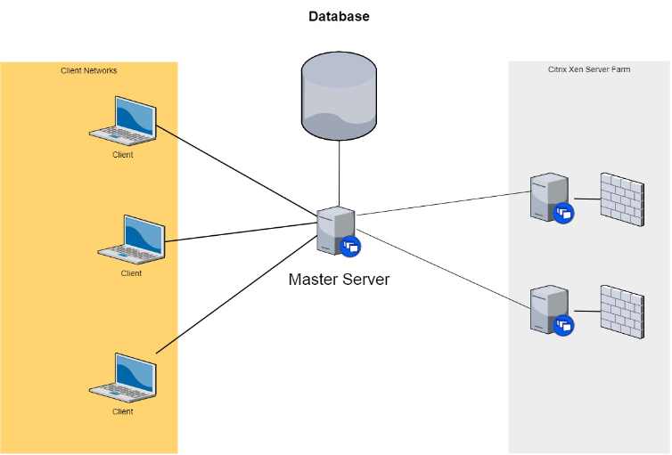
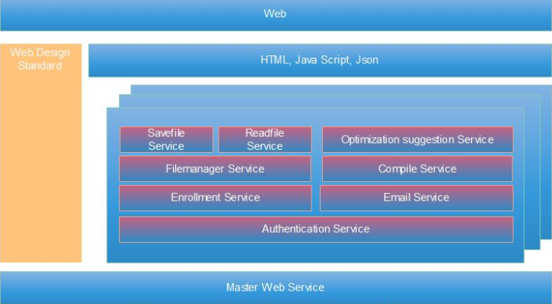
Code Manager Ashutosh Kakadiya Harsh Mehta Mihir Gajjar Shreyas Patel Mentor: Dr. Sanjay Chaudhary Project executed during: Monsoon 2017 Program: B.Tech ICT
￼
Introduction Designed a cloud based Software-as-a-Service (SaaS) application so that prospective users (programmers and developers) can open it in a web browser, and access application by services. These services provide the user an interface with features like code compilation, execution, storage, analysis and also provides suitable optimisations as suggestions, if required. | Cloud Architecture
Implementation Successfully integrated compilers at server side Created service oriented architecture for Code Editor Implemented authentication service for user SignIn/SignUp Designed a database and integrated it with the system Implemented file storage system – Users can store their code on cloud Users can show their activity on their dashboard Developed an optimization service
Future Work Provide code optimization for C, C++, Python Provide same set of service for other popular programming languages Provide solution to error generated during compilation.

